Slide 1
Divide and Conquer

Slide 2

Divide and Conquer
Recursively:
Divide the problem into a number of sub-problems
Conquer the sub-problems by solving them recursively
Combine the solutions to the sub-problems into the solution for the original problem
General recurrence: T(N) = aT(N/b) + f(N)
Cases solved by divide and conquer
❖ The maximum subsequence sum – the O( N log N ) solution
❖ Tree traversals – O( N )
❖ Mergesort and quicksort – O( N log N )

Slide 3
Closest Points Problem
Divide and Conquer
Given N points in a plane. Find the closest pair of points. (If two points have the same position, then that pair is the closest with distance 0.)
➢ Simple Exhaustive Search
Check ? pairs of points. T = O( ? ).
N ( N – 1 ) / 2
N ²
➢ Divide and Conquer – similar to the maximum subsequence sum problem
〖Example〗
Sort according to
x-coordinates and
divide;
Conquer by forming
a solution from left,
right, and cross.

Slide 4

Divide and Conquer
It is O( N log N ) all right.
But is it really
clearly so?
It is so simple,
and we clearly have an
O( N log N ) algorithm.
How about f (N)?
Can you find the cross distance
in linear time?
Just like finding
the max subsequence sum,
we have a = b = 2 …

Slide 5
Divide and Conquer
 Recall: T(N) = 2T(N/2) + cN
= 2[ 2T(N/2²) + cN/2 ] + cN
= 2² T(N/2²) + 2cN
= ……
= 2^{k} T(N/2^{k}) + kcN
= N + c NlogN = O( NlogN )
if T(N) = 2T(N/2) + cN²
= 2[ 2T(N/2²) + cN²/2² ] + cN²
= 2² T(N/2²) + cN²(1+1/2)
= ……
= 2^{k} T(N/2^{k}) + cN²(1+1/2+…+1/2^{k-1} )
= O( N² )

Slide 6

Divide and Conquer
δ - strip
If NumPointInStrip = , we have
/* points are all in the strip */
for ( i=0; i<NumPointsInStrip; i++ )
for ( j=i+1; j<NumPointsInStrip; j++ )
if ( Dist( P_{i} , P_{j} ) < δ )
δ = Dist( P_{i} , P_{j} );
The worst case: NumPointInStrip = N
δ
δ
/* points are all in the strip */
/* and sorted by y coordinates */
for ( i = 0; i < NumPointsInStrip; i++ )
for ( j = i + 1; j < NumPointsInStrip; j++ )
if ( Dist_y( P_{i} , P_{j} ) > δ )
break;
else if ( Dist( P_{i} , P_{j} ) < δ )
δ = Dist( P_{i} , P_{j} );
The worst case:
For any p_{i} , at most 7 points are considered.
f (N) = O( N )

Slide 7
Divide and Conquer
Three methods for solving recurrences:
T( N ) = a T( N / b ) + f ( N )
☞ Substitution method
☞ Recursion-tree method
☞ Master method
 Details to be ignored:
 if (N / b) is an integer or not
 always assume T( n ) = Θ( 1 ) for small n

Slide 8
Divide and Conquer
☞ Substitution method
— guess, then prove by induction
〖Example〗 T( N ) = 2 T( ⎣N / 2⎦ ) + N
Guess: T( N ) = O( N log N )
Proof: Assume it is true for all m < N, in particular for m = ⎣N / 2⎦ .
Relax!
As long as we can choose
sufficiently large c so that
it is true for T(2) and T(3).
Then there exists a constant c > 0 so that T(⎣N / 2⎦ ) ≤ c ⎣N / 2⎦ log ⎣N / 2⎦
Oh yeah? How about
N = 1???
Substituting into the recurrence:
T( N ) = 2 T( ⎣N / 2⎦ ) + N
≤ 2 c ⎣N / 2⎦ log ⎣N / 2⎦ + N
≤ c N (log N – log 2) + N
≤ c N log N for c ≥ 1

Slide 9
Divide and Conquer
〖Example〗 T( N ) = 2 T( ⎣N / 2⎦ ) + N
Wrong guess: T( N ) = O( N )
Proof: Assume it is true for all m < N, in particular for m = ⎣N / 2⎦ .
T(⎣N / 2⎦ ) ≤ c ⎣N / 2⎦
Substituting into the recurrence:
T( N ) = 2 T( ⎣N / 2⎦ ) + N
≤ 2 c ⎣N / 2⎦ + N
≤ cN + N = O( N )
❒
How to make a good guess?
Must prove the exact form

Slide 10










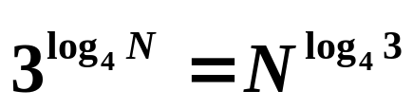
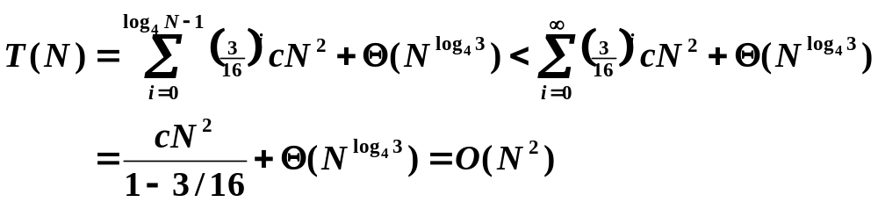
Divide and Conquer
☞ Recursion-tree method
〖Example〗 T( N ) = 3 T( N / 4 ) + Θ( N² )
T( N )
c N²
……
…… …… …… …… …… ……
Notes:
可以用substitution验证这个上界

Slide 11




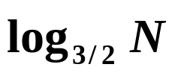





Divide and Conquer
〖Example〗 T( N ) = T( N / 3 ) + T( 2N / 3 ) + cN
Not complete!
Guess:
Proof by substitution:
for

Slide 12








Divide and Conquer
☞ Master method
【Master Theorem】Let a ≥ 1 and b > 1 be constants, let f(N) be a function, and let T(N) be defined on the nonnegative integers by the recurrence T(N) = aT(N/b) + f(N). Then:
If for some constant , then
If , then
If for some constant , and if for some constant c < 1 and all sufficiently large N, then
regularity condition
〖Example〗 Mergesort has a = b = 2, and case 2
T = O( N log N )
〖Example〗 a = b = 2, f (N) = NlogN ?
❒
T = O( N log N )
Notes:
注：f(N)和N*之间比较大的那个，决定了T(N)。
必须严格大，大于某个多项式阶

Slide 13
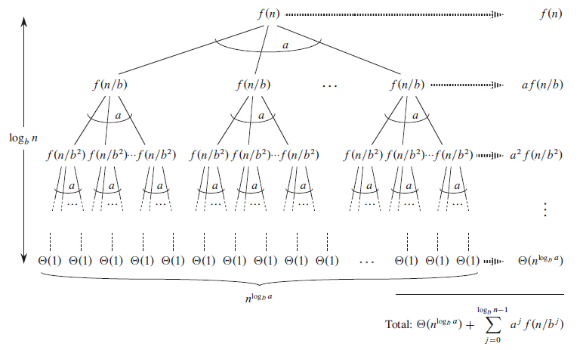
Divide and Conquer
Proof by recursion tree: for n = b^{k} for some integer k

Slide 14
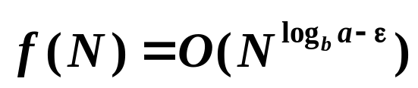
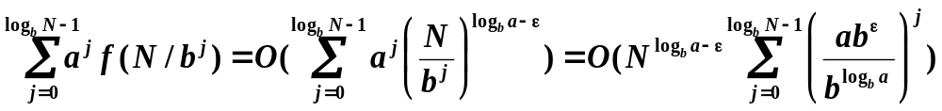
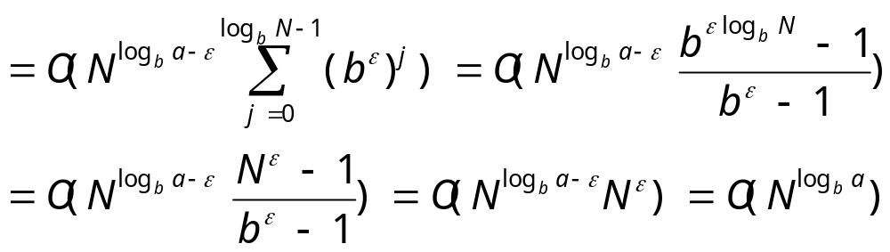
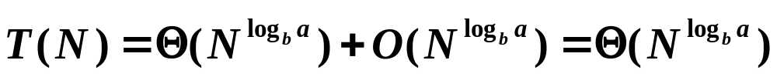

Divide and Conquer
For case 1 where
= a
Read Ch.4 of “Introduction to Algorithms” for the rest of the proof.
Discussion 9:
Please prove case 2.

Slide 15

Divide and Conquer
☞ Master method – another form
【Master Theorem】The recurrence T(N) = aT(N/b) + f(N) can be solved as follows:
If af(N/b) = κ f(N) for some constant κ < 1, then
If af(N/b) = K f(N) for some constant K > 1, then
If af(N/b) = f(N), then
〖Example〗 a = 4, b = 2, f (N) = NlogN
?
T = O( N² )
Notes:
倒数第二行公式的意思，用前一个定理可以解决

Slide 16
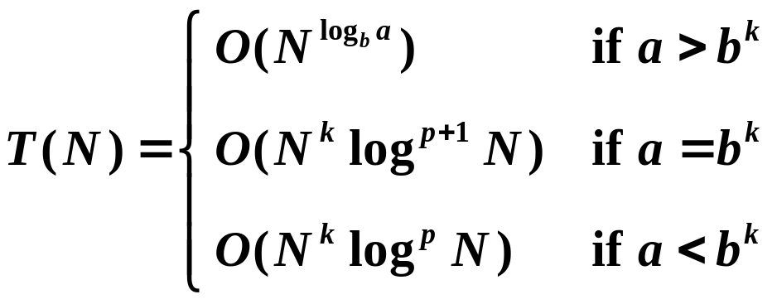
Divide and Conquer
【Theorem】The solution to the equation
T(N) = a T(N / b) + Θ(N^{k} log^{p}N ),
where a ≥ 1, b > 1, and p ≥ 0 is
〖Example〗 Mergesort has a = b = 2, p = 0 and k = 1.
T = O( N log N )
〖Example〗 Divide with a = 3, and b = 2 for each recursion;
Conquer with O( N ) – that is, k = 1 and p = 0 .
T = O( N^{1.59} )
If conquer takes O( N² ) then T = O( N² ) .
〖Example〗 a = b = 2, f (N) = NlogN
T = O( N log² N )

Slide 17
Reference:
Introduction to Algorithms, 3rd Edition: Ch.4, p. 65-113； Thomas H. Cormen, Charles E. Leiserson, Ronald L. Rivest and Clifford Stein. The MIT Press. 2009
Data Structure and Algorithm Analysis in C (2nd Edition)：Ch.10，p.370-375；M.A.Weiss著、陈越改编，人民邮件出版社，2005
Lecture Notes of CS 373: Combinatorial Algorithms: Notes on Solving Recurrence Relations, p.10-13; Jeff Erickson, University of Illinois, Urbana-Champaign, 2003

